Slide 1

Irma Crisis
Management

Slide 2
Problem statement
Hurricane Irma has hit the United states of America hard, leaving people from many states in panic and fear.
Many of the civilians had problem with the following :
  No Real time access to news
  Information about the current status of the hurricane
  Evacuation Information
  Safe Routes to travel during evacuation
  Previous Statistics about hurricanes

Slide 3
Introduction
What if a proper information-architecture is created to solve the issue and help individuals get the most of the website ?
Information Architecture and Navigation are the keys to the success of a website.

Slide 4
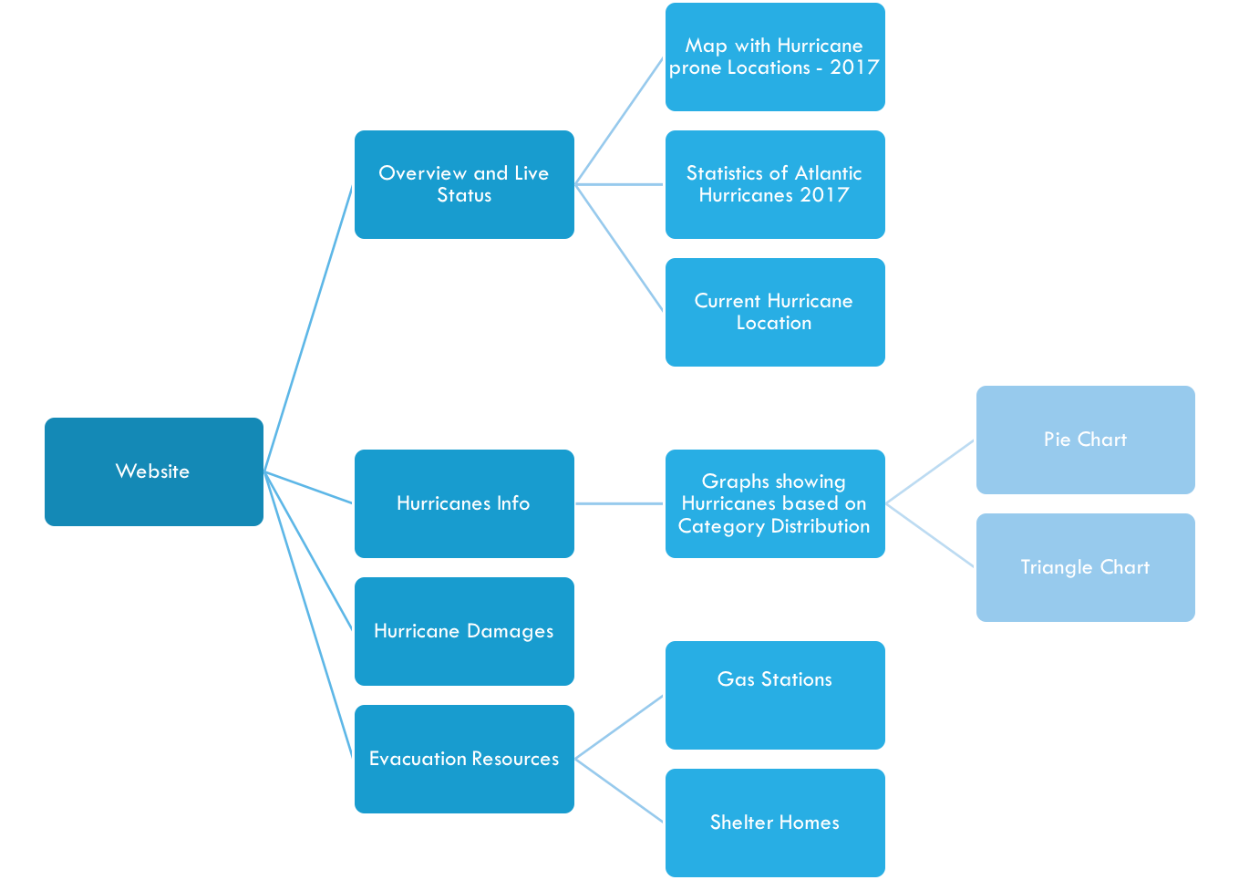
Information Architecture

Slide 5
Key Design Features
Minimalism
Emphasis on User Experience
Subtle Animations and transition effects
More than 15 different CSS effects/animations implemented.
Consistency in Color Palette Selection

Slide 6
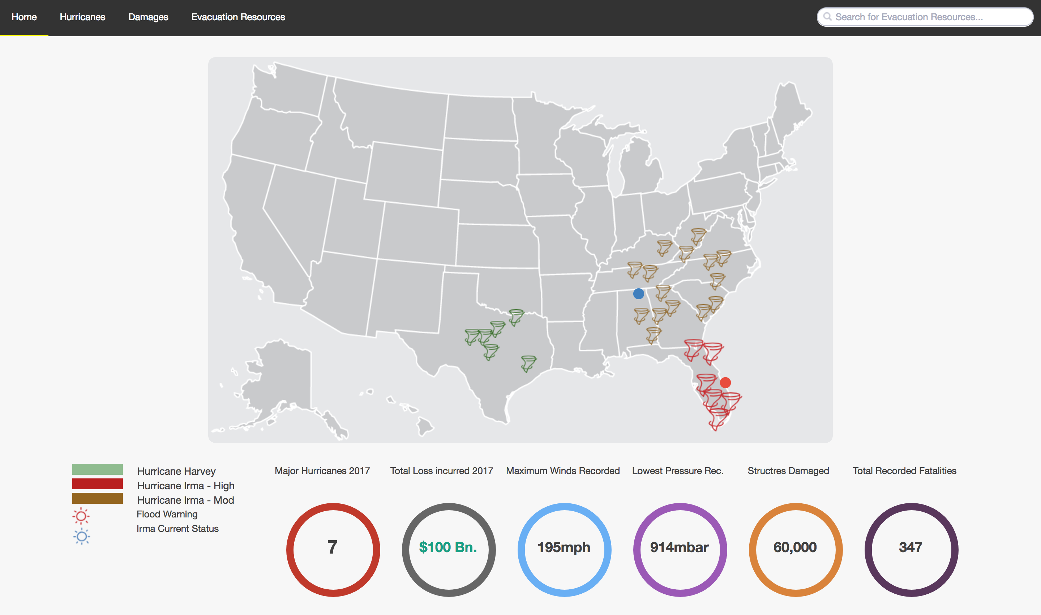
1

